Slide 1

BISHOPS’ CONFERENCE
OF SCOTLAND
GDPR Training Day
Monday 14th May 2018
Donna Maguire
Archivist and Records Manager to the Bishops’ Conference of Scotland
Notes:
Welcome and a big thanks to David for putting the GDPR in its global context.

Slide 2














Liturgy Commission
Agencies of the Bishops’ Conference of Scotland
Permanent Diaconate
Ecumenical Reference Group
Secretary of the Committee for Church Music
Notes:
There are 19 Agencies / Commissions that help carry out the work of the Bishops’ Conference. These Agencies have an advisory function but some also have executive functions; most are semi- autonomous, but all create records. All hold personal and sensitive information, from list of contributors to personal medical records. The new Data Regulation gives people a bigger say in what we do with their information. It is our responsibility to manage that information in a responsible and transparent way.
This will mean some big changes for people. But rather than a bad thing we should see this as an opportunity to look at what we DO and how can we do it better.

Slide 3
BCOS policies
A Brief Guide to Data Protection
Information Audit Guide and Worksheet
Retention and Disposal Guide and Schedule
Data Protection Policy
Computer Usage Policy
Data Breach Procedures
Data Breach Report Form
Subject Data Access Form
Templates for Keeping in Touch
Email Usage Policy
Notes:
We have over the past few months been working on new policies, procedures. Pro rata forms and guides to help us all adjust to this new way of working. We have tried to prepare you for these changes by sending out Advice Notices, I hope that these have been useful and mean that a lot of the information that we are presenting to you today will not be a total shock.
What you’ve received so far …..
A brief Guide to Data Protection
Information Audit Guide and Work Sheet – which I will run through in more detail today
We were hoping to send out more but time got away from us - so I have prepared a Pack for you today
In the pack that you will not have seen before are
Retention and Disposal Guide and Schedule – which will help you determine what to keep and what to destroy.
Data Protection Policy
Computer Usage Policy
Data Breach Procedures
Data Breach Report Form
Subject Data Access Form
Templates for keeping in touch
Email Usage Policy – Perhaps the biggest change to how we work and James and Elizabeth will take you through this afternoon
We know this is a lot to take in. As a said before this is an opportunity to freshen our way of working.
Helping to protect:
those we serve,
ourselves,
the organisation.

Slide 4
Information Audit
Document all the personal data we hold and why we have it
Identify why we have personal data and how we use it
Be prepared for when people ask for their right to see what we hold on them
Before collecting data we need to tell people why we need it and how we will use it
We need to review our Data Security
Know what to do if a breach occurs
Notes:
What I want to do is take you thru the Information Audit Guide
What do we need to do –
We need to Fully document the personal data we hold and why
We need to Identify why we have personal data and how we use it
We need to be Ready for when people ask for their right to see what we hold on them
Before we collect any data we need to tell people why we need it and how we will use it
We need to review our DATA Security
We need to Have contingency plans in place if a breach occurs.
When we were developing the information audit we realised that we were asking people to work in a new way.
We were asking you to ask yourself some basic question
How much information does your Organisation / Office hold
Who manages this information

Slide 5
What is a Information Audit (1)
Identify what information you hold
Understand your reasons for having the information
  Ability to manage ‘change’
  Improved understanding of information risk
  Identification of potential savings and efficiencies.
Notes:
We have developed the information audit to help you
Identify what information you hold
By Understanding your reasons for having the information
We know this is a difficult task but there are some benefits to this process
The ability to manage change ( staff, clients, objectives…)
It will improve your understanding of information risk ( cost of losing it, potential litigation, loss of credibility…)
- It will allow you to Identify potential savings and efficiencies.
But the main reasons for carrying out an Information audit is so we comply with the new Data Protection Regulation.

Slide 6
What is a Information Audit (2)
Manage your Digital and Physical information
Ensure you comply with GDPR
  Accountability
  Legally
  Effectively and Efficiently
Notes:
What will the Information Audit do for you ?
it will help you manage your digital and physical information
it will ensure you comply with GDPR
You will be able to operate with accountability. Legal and effective and efficient manner

Slide 7
What is a Information Audit (3)
What are we trying to achieve ?
  Protect Reputation
  Make Informed Decisions
  Avoid and Reduce Costs
  Deliver a Better Service
Notes:
What are we trying to achieve – apart from complying with the new regulation ?
We are trying to protect our reputation,
Make informed decisions about the information we hold
A knock on effect of knowing more about the information we hold will allow us to be more efficient. (eliminate duplication, reduce what we are required to hold,…)
In general deliver a better service.

Slide 8
What is a Information Audit (4)
Why ???
Notes:
Why ???
Because lost of information as a result of mismanagement has serious consequences:
for the Data Subject,
for you,
your agency,
the RC Church in Scotland,
And Me as your data controller

Slide 9
How do I create an Information Audit
What you are trying to achieve and what are your priorities?
What do you want to do with the information you are gathering?
What can you practically achieve?
What risks do you need to mitigate?
What benefits do you hope to achieve?
What areas need the most urgent attention?
Notes:
You need to ask yourself :
• what you are trying to achieve and what are your priorities?
• what do you want to do with the information you are gathering?
• what can you practically achieve?.
• what risks do you need to mitigate?
• what benefits do you hope to achieve?
• what areas need the most urgent attention?
We are asking you to consider how, when and why you collect peoples information.
Hopefully once you have asked these questions you will have a good idea where to start

Slide 10
The MANTRA
Keep it Simple
Notes:
My mantra is Keep it Simple

Slide 11
Grouping Information
How to group information
  Constituent parts need to be brought together as a single unit
  All items relating to a project
    Paper – in filing cabinet
      Photocopies, photographs, accounts, maps etc…
    Database – on computer
      Lists, spreadsheets etc…
    Correspondence in both paper and email system
    Notes, minutes, telephone messages etc…
Notes:
Think of organising information in Groups. Bringing together information that is relevant to each other (eg collections, projects...)
Each group / collection / project can then be managed as a single unit.
All items relating to a project – regardless of format – can then be organised, starting from a broad definition of the ‘group’ (ie Title)
then, if required for further subdivided into more manageable groupings.
All items relating to a project
Paper – in filing cabinet
Photocopies, Photographs, accounts, maps, etc…
Database – on computer
List, spreadsheets etc…
Correspondence in both paper and email system
Notes, minutes, telephone messages etc.
These are often stored in different ways and places.
You need to know where the constituent parts of the group is
how is it stored,
who has access
what would happen if you lost any of it.

Slide 12
Data Value
Value to the organisation
  Will it cost to re-acquire the information
  Would there be legal, reputational or financial repercussion
  Would it affect how you do your job if you couldn’t access it
  What are the consequences of not having the information
  What are the risk
Notes:
Ask yourself
Does your information have Value to the organisation
Will it cost to reacquire it
Would there be legal, reputational or financial repercussion
Would it affect how you do your job if you couldn’t access it
What are the consequences of not having the information
What are the risk…

Slide 13
Risk
What are the RISKS ?
  Loss
  Not Accurate
  Tampering
  Inappropriate Disclosure
Notes:
What are the RISKS
Loss – what would happen if you permanently lost your information
Not accurate – can you trust the accuracy of your data, has it been superseded / updated / corrupted (ie. is it out of date)
Tampering – can you trust it has not been tampered with (ie who has permission to access / edit the data)
Inappropriate disclosure – could it be disclosed either by accident or on propose.

Slide 14
Finding information
  How will you find the information?
    It must be possible to find generic information from your filing and email system without referencing specific names, to meet privacy requirements.
    It must be possible to search within the information to find files created within a specific date range.
Notes:
How will you find your information
It might be as simple as looking in a filing cabinet but it could be as a complex digital search of emails.
Here are two example of what type of search your might be required to do under GDPR
It must be possible to find generic information from your filing and email system without referencing specific names, to meet privacy requirements.
It must be possible to search within the information to find files created within a specific date range.
It is important to consider these requirements because they impact upon how you store your information and any aids/technology used for searching and indexing it. Databases like MS Access are great in storing and sorting information but they are bad at searching for information.

Slide 15
Access
  Who has access to the information and how?
    Are the individual files inside an information group ‘private’, requiring only the person that created the file to be able to access the information?
    Is everything within the information group protectively marked allowing only those with the right clearance to access them?
    Can the information within the information group be published openly?
    Will you be able to release individual items inside the information group within 20 working days of a request?
Notes:
In order to comply with GDPR we have to be able to complete subject information requests.
To do this we need to be able to do all four of these examples:
Are the individual files inside an information group private, requiring only the person that created the file to be able to access the information?
Is everything within the information group protectively marked allowing only those with the right clearance to access them?
Can the information within the information group be published openly?
Will you be able to release individual items inside the information group within 20 working days of a request?

Slide 16
Information Audit
  Using the Excel Spreadsheet
Notes:
Using the Excel Spreadsheet - this is what your being asked to do.

Slide 17
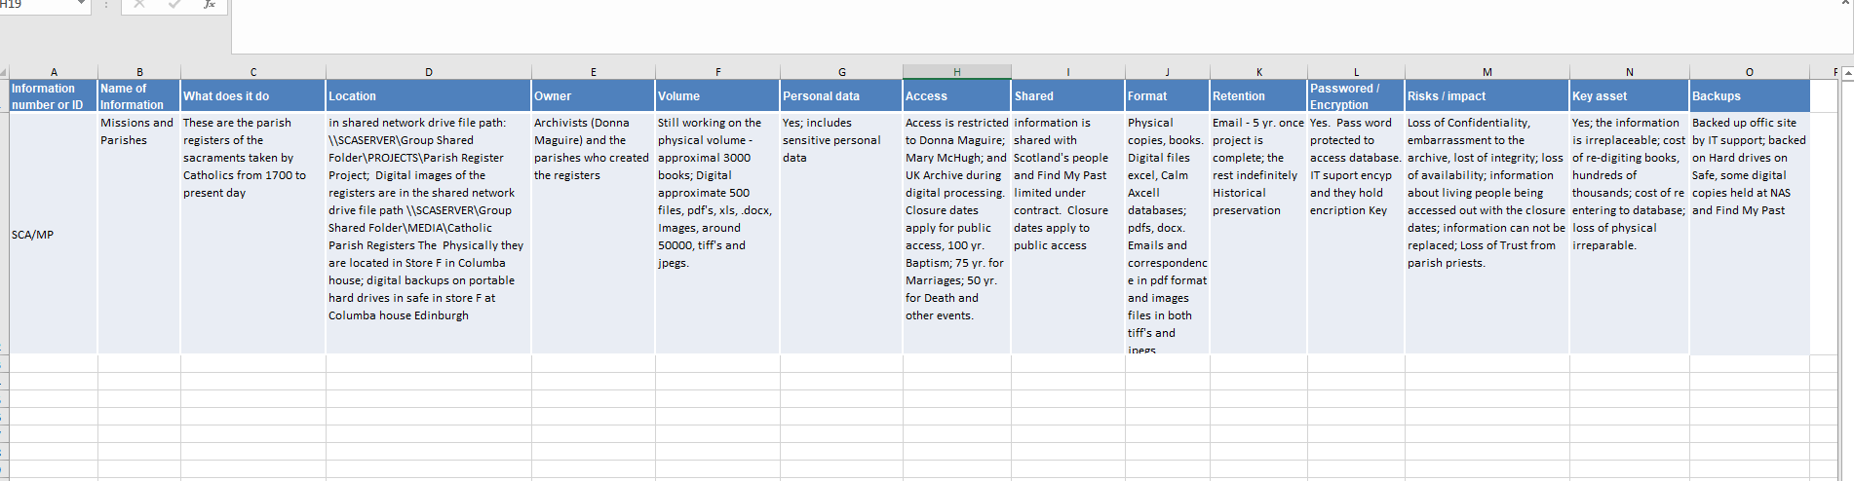
Information Audit
Notes:
Screen shot from the template spread sheet we sent round with example from the Archive on my Missions and Parishes collection.
This is just a start for me.
This was from the top of my head, I was able to fill each field with the information I knew about the collection where its was stored etc.
I now need to go back over this and make sure the information is correct.
My point here is you already know this. You do it every day.
When you are asked for something you know where to find it or you know someone who does.
So its nothing to be overwhelmed by.

Slide 18
Information Audit
Name of Information Group | -Name of Information Group -How do you identify the information? (This could be a project, a collection, an event etc.)
What does it do | -Brief description of what the information is -More detail on what the components of the information are -Whose information
Location | -Where is the information located? -What is the file-path? -Local hard drive, external drive, shared network drive? -Where is its physical location, i.e. filing cabinet, building, safe, etc.
Owner | -Who created the information, or where does the information come from? -Who is the Information Owner? -Which department holds responsibility for the information? -Who are the stakeholders?
Volume/Size | -What is the size of the information? i.e. filing cabinet drawers; paper file boxes; digital files kb/Mb; etc.
Personal data | -Does the asset include sensitive personal data? N.B. This is very important for Data Protection.
Access | -What part of the office/agency does this asset support? -Who is at risk from the information -How will you find the information? -Who can open the information and how? -How do you need to be able to work with the information? -What do you need to be able to understand about your information? -To what extent do you trust your information is what it claims to be?
Shared | -Who is the information shared with? (Is it shared with other agencies out with the BCOS)? Under what agreement is the information shared?
Format/Media | -What format is the information saved in? i.e. digital file format; paper format; audio; video; etc…
Retention | -How long should it be kept in immediate access? -What should happen to it when it no longer needs immediate access? -What are the disposal requirements?
Password/Encryption | -is your information password protected? – who has the password? -is your information encrypted? – who has the encryption key?
Risks / impact | -What are the risks to the information? -What are the risks to the office/agency from the information (for example from its loss, corruption or inappropriate access)?
Key Information | -What is the value to the office/agency? -What would be the cost of replacing the information?
Backups | -is your data backed up? -where is it backed up? (off site etc.); how is it backed up?
Notes:
In the Guide we take you through each of the 15 Fields of information that we require to stay compliant.
Its hard to present these in such a way that makes it clear So I’ve taken each Field and broken that down.

Slide 19
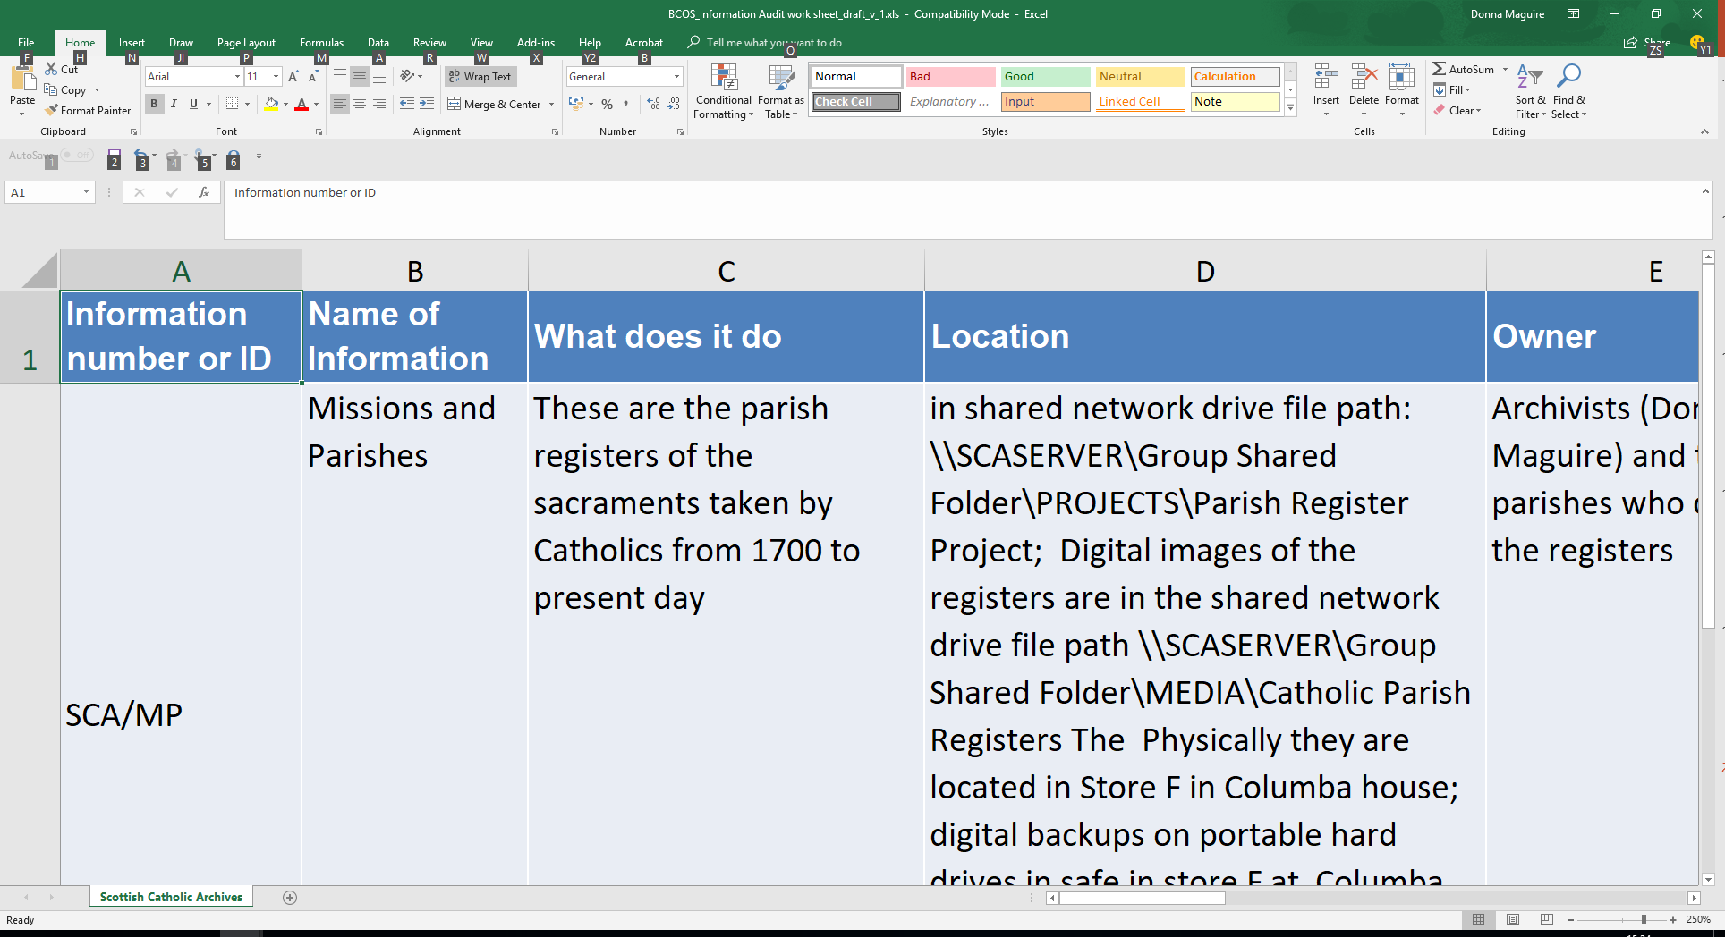
Information Audit
Notes:
Information Number or ID is an identifier - this can be used to recall the Information Group
You create the id number and eventual ‘key’ of these to be able to locate your information groups

Slide 20

Information Audit
Name of Information Group | -Name of Information Group -How do you identify the information? (This could be a project, a collection, an event etc.)
Notes:
Name of Information Group – this is the name you give the group

Slide 21

Information Audit
What does it do | -Brief description of what the information is -More detail on what the components of the information are -Whose information
Notes:
This is a simple description of what this Information Group is all about

Slide 22
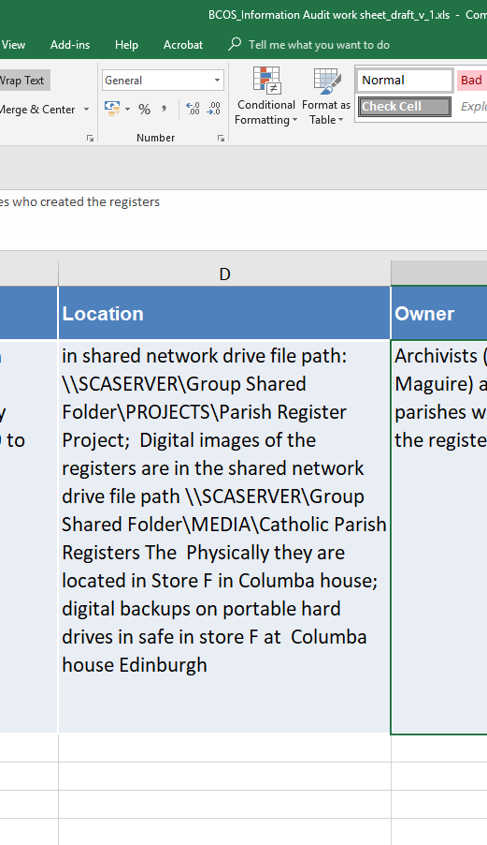
Information Audit
Location | -Where is the information located? -What is the file-path? -Local hard drive, external drive, shared network drive? -Where is its physical location, i.e. filing cabinet, building, safe, etc.
Notes:
For the ‘Information Group’

Slide 23

Information Audit
Owner | -Who created the information, or where does the information come from? -Who is the Information Owner? -Which department holds responsibility for the information? -Who are the stakeholders?
Notes:
Owner is a strange term in this context. Its more the user, some times the creator, who is responsible for the information. Its important because is says something about the authenticity of the information can you .

Slide 24
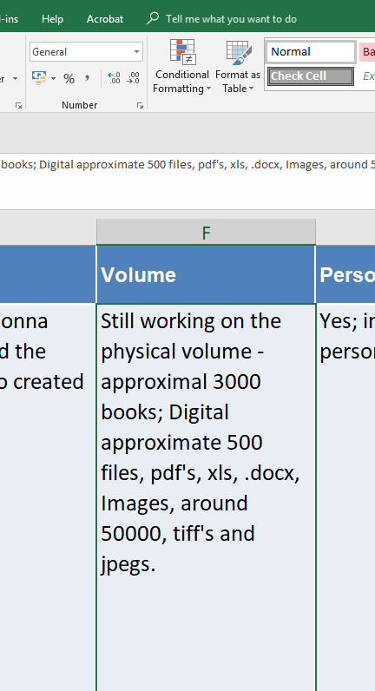
Information Audit
Volume/Size | -What is the size of the information? i.e. filing cabinet drawers; paper file boxes; digital files kb/Mb; etc.
Notes:
Information Group volume / size / physical - digital presence

Slide 25
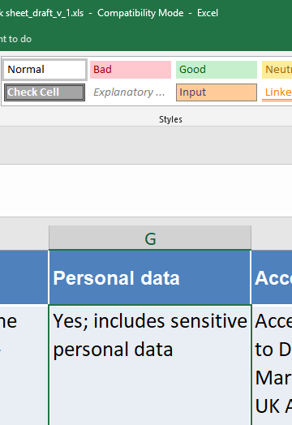
Information Audit
Personal data | -Does the Group include sensitive personal data? N.B. This is very important for Data Protection.
Notes:
Does the Information Group hold any Sensitive or Personal DATA

Slide 26
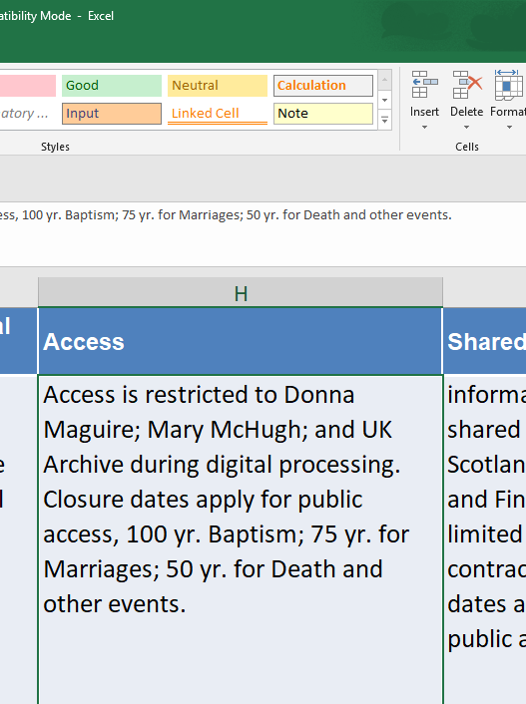
Information Audit
Access | -What part of the office/agency does this Group support? -Who is at risk from the information -How will you find the information? -Who can open the information and how? -How do you need to be able to work with the information? -What do you need to be able to understand about your information? -To what extent do you trust your information is what it claims to be?
Notes:
Access requirements for the Information Group

Slide 27
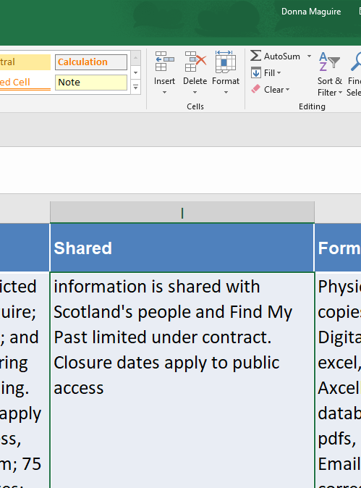
Information Audit
Shared | -Who is the information shared with? (Is it shared with other agencies out with the BCOS)? Under what agreement is the information shared?
Notes:
Is the information within the Group shared and how is this controlled

Slide 28
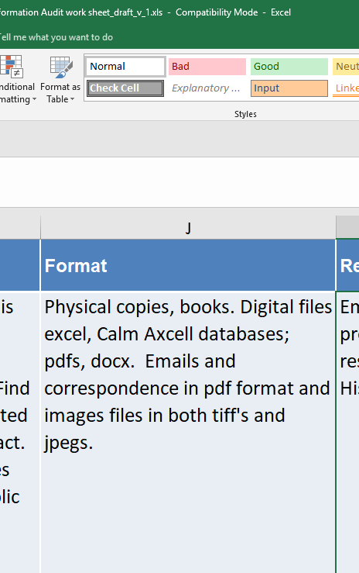
Information Audit
Format/Media | -What format is the information saved in? i.e. digital file format; paper format; audio; video; etc…
Notes:
Information form – Physical ; Digital ; media ;etc

Slide 29
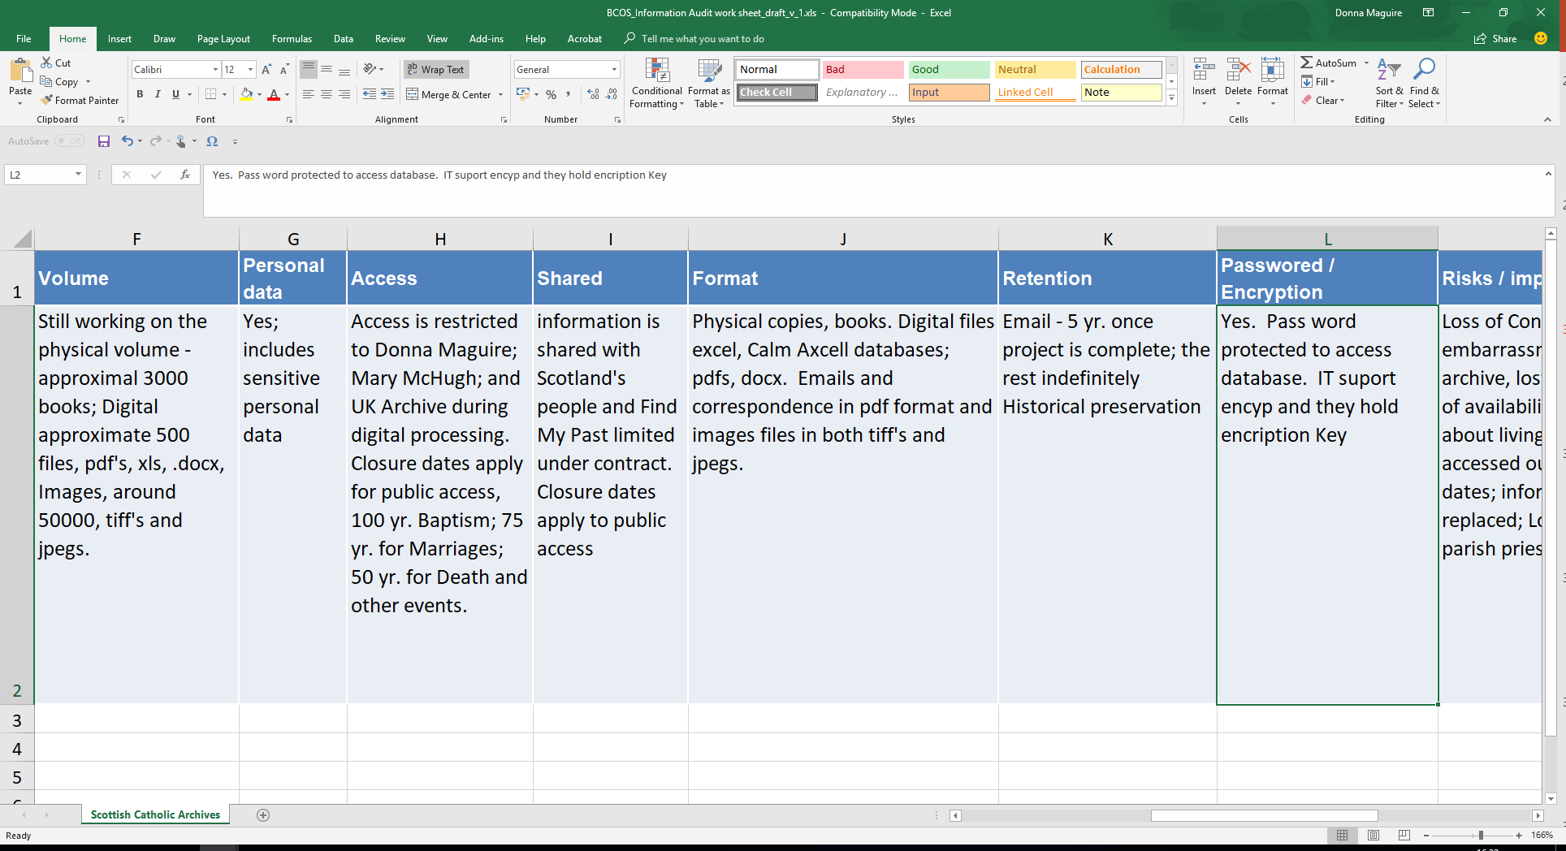
Information Audit
Retention | -How long should it be kept in immediate access? -What should happen to it when it no longer needs immediate access? -What are the disposal requirements?
Notes:
Retention Policy for the Information within the Group

Slide 30
Information Audit
Password/Encryption | -is your information password protected? – who has the password? -is your information encrypted? – who has the encryption key?
Notes:
Access control for the Information in the Group

Slide 31
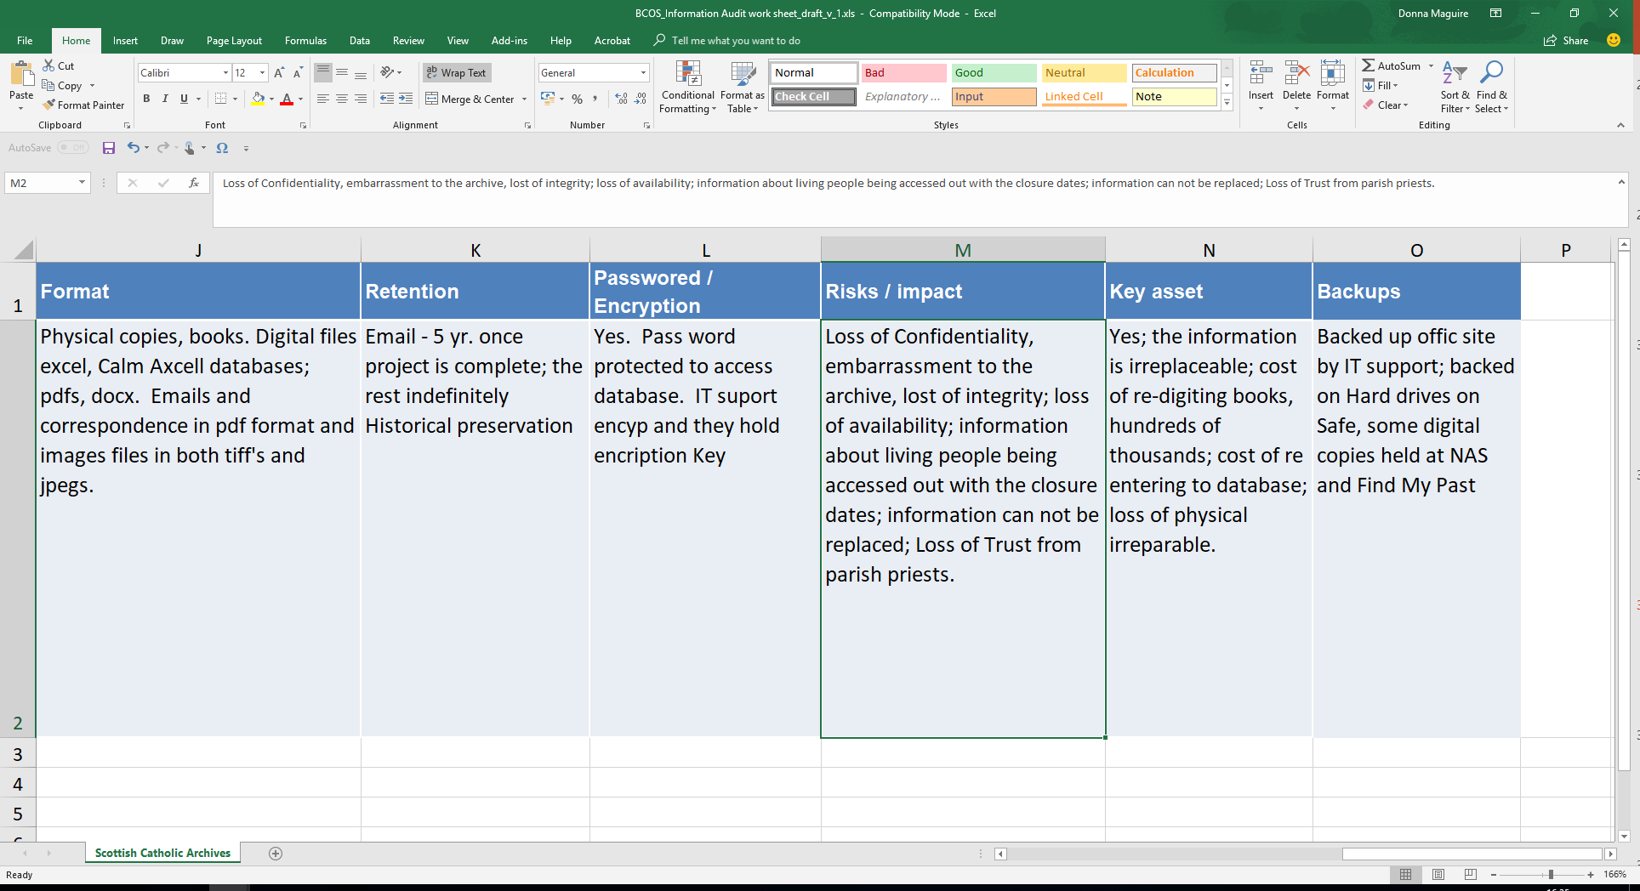
Information Audit
Risks / impact | -What are the risks to the information? -What are the risks to the office/agency from the information (for example from its loss, corruption or inappropriate access)?
Notes:
Risks

Slide 32
Information Audit
Key Information | -What is the value to the office/agency? -What would be the cost of replacing the information?
Notes:
Key asset ➔ Key Information

Slide 33
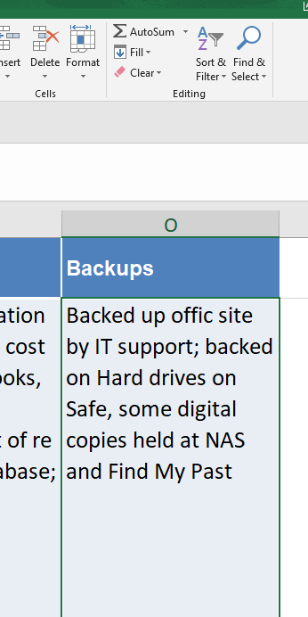
Information Audit
Backups | -is your data backed up? -where is it backed up? (off site etc.); how is it backed up?

Slide 34
Retention Schedules
  Retention Schedules

Slide 35
Retention Schedules
  Retention Schedules are developed from a combination of
  Legal Requirements
  Business Guidelines
  Canon Law
Notes:
Retention Schedules have been developed with respect to the organisations needs, legal requirements, Canon Law.
These are not definitive, if you find something is not covered in the Retention Schedule, then come back to me with it and we will try to find the most appropriate Retention rule for it.
The Retention periods are fixed in some case but are flexible for others.
If there is a strong business reason to retain or destroy anything then discuss it with me and we will proceed.

Slide 36
Data Breach
  Data Breach

Slide 37
Data Breach
  What is a Data Breach?
  “a breach of security leading to the accidental or unlawful destruction, loss, alteration, unauthorised disclosure of, or access to, personal data transmitted, stored or otherwise processed”
Notes:
What is a data breach?
“a breach of security leading to the accidental or unlawful destruction, loss, alteration, unauthorised disclosure of, or access to, personal data transmitted, stored or otherwise processed”
A Data Breach could be spotted in a number of whys
Email has been sent in error and the recipient lets you know
Information sent to the wrong person
Third party – police, contractor member of public.
An internal audit

Slide 38
Data Breach
What to do if you have a Data Breach
Immediately Report the Breach to the Data Controller
There will be an Investigation
Remedial action
Complete Data Breach Report
Decide if the incident involves personal data or is it a “near miss”
Decide if it is necessary to report it to the ICO and individuals concerned
Report to ICO
Notify Data Subjects
Notes:
What to do if you have a Data Breach
Repot the Breach to the Data Controller
They will Investigate
Remedial action
Complete Data Breach Report
decide if the incident involves personal data or is it a “near miss”
Decided if it is necessary repot to ICO and individuals concerned
Report to ICO
Notify Data Subjects

Slide 39
Data Breach
Follow Up
Learn from our Mistakes
Meeting to workout ‘what happened’ - Causes
Prevention – MUST NOT happen again
The incident needs to be Logged centrally
  This will be done at the archive
Notes:
Follow Up
Learn form our Mistake
Meeting to workout what happened - Causes
Prevention – can’t happen again
The incident needs to be Logged centrally
This will be done at the archive

Slide 40
GDPR
Thank you
Donna Maguire
Phone/ 0131 556 3661
Email/ archivists@scarchives.org.uk
Columba House
16 Drummond Place
Edinburgh
EH6PL

